Slide 1

TECHAGENT
Navigate the AI Economy
TechCoinAgent (TCA) · Base ERC-20 · Pitch Deck v1.0

Slide 2
WHY WE EXIST
Mission
“While we still spark desire, can evaluate outcomes and the realization of ideas — let us help one another navigate the new, exciting and highly competitive world of artificial intelligence.”

Slide 3
AI MARKET IS FRAGMENTED
The Problem
• The number of AI tools grows faster than anyone can track
• No objective way to compare quality, cost and outcomes
• Weak trust signals — decisions driven by hype
• Businesses can't estimate real ROI
• Vendors face rising acquisition costs & a trust deficit

Slide 4
ONE ENTRY POINT INTO AI
The Solution
• Catalog of AI services with use-case filtering
• Comparison engine: quality · cost · outcomes
• AI agents marketplace (workflows & automations)
• Outcome-based community reputation
• B2B / API layer for enterprise routing
• TCA — aligned utility & incentive token

Slide 5
WHAT USERS GET
Product
• Platform Access — Pay for premium features and expanded access across TECHAGENT.
• AI Agents & Workflows — Pay to run AI agents and automation templates from the marketplace.
• Staking — Stake TCA for discounts and expanded service access.
• Governance — Vote on platform development and ecosystem parameters.
• Community Rewards — Earn for reviews, data contributions and catalog curation.

Slide 6
THREE-TIER GO-TO-MARKET
Market
• B2C — creators, freelancers, students, consumers (mass adoption)
• SMB — AI for marketing, support, sales, operations (monetization)
• B2B / API — enterprise routing, white-label, benchmarking (scale)

Slide 7
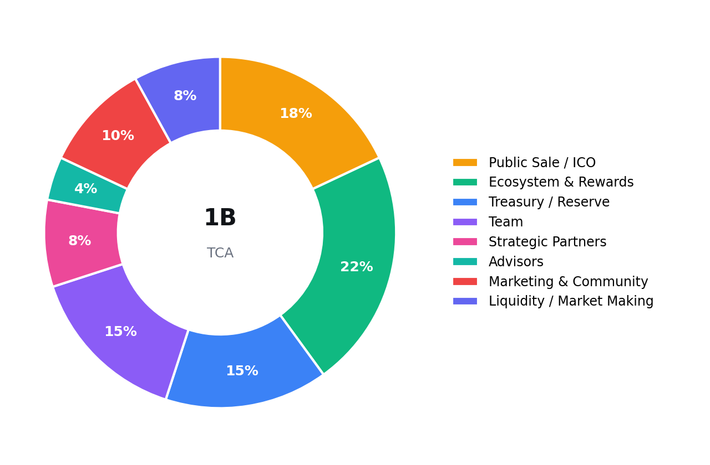
TOTAL SUPPLY 1,000,000,000 TCA
Tokenomics

Slide 8
PRELIMINARY — SUBJECT TO CHANGE
ICO Terms
Public Sale Price: $0.020 per TCA
Public Sale Amount: 180,000,000 TCA
Soft Cap: $1,500,000
Hard Cap: $3,600,000
Circulating at TGE: ~150,000,000 TCA (15%)
Initial Market Cap: ~$3,000,000
Fully Diluted Valuation (FDV): $20,000,000

Slide 9
ALIGNED INCENTIVES
Vesting
• Public Sale: 20% at TGE · cliff — · Linear over 6 months
• Team: 0% at TGE · cliff 12 months · Linear over 24 months
• Advisors: 0% at TGE · cliff 6 months · Linear over 12 months
• Strategic Partners: 0% at TGE · cliff 3 months · Linear over 12 months
• Marketing & Community: Partial at TGE · cliff — · 24 months
• Ecosystem & Rewards: Partial at TGE · cliff — · 48 months (KPI-based)
• Treasury: By governance at TGE · cliff N/A · Unlocked by vote

Slide 10
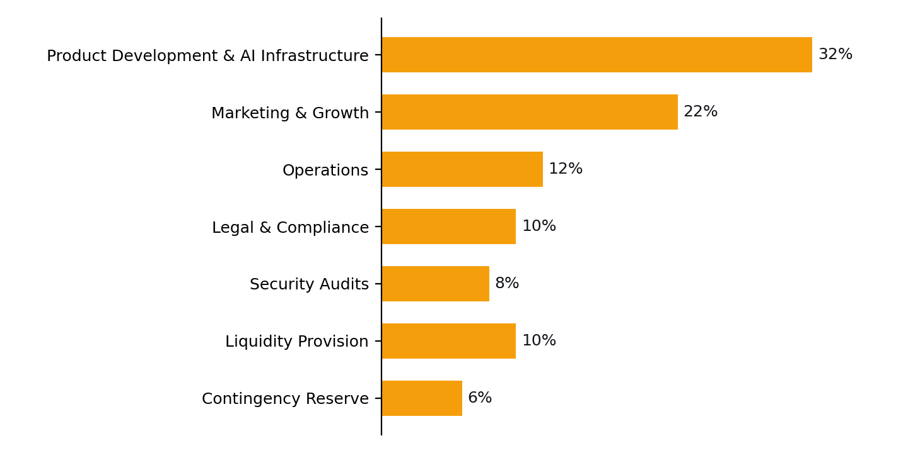
Use of Funds

Slide 11
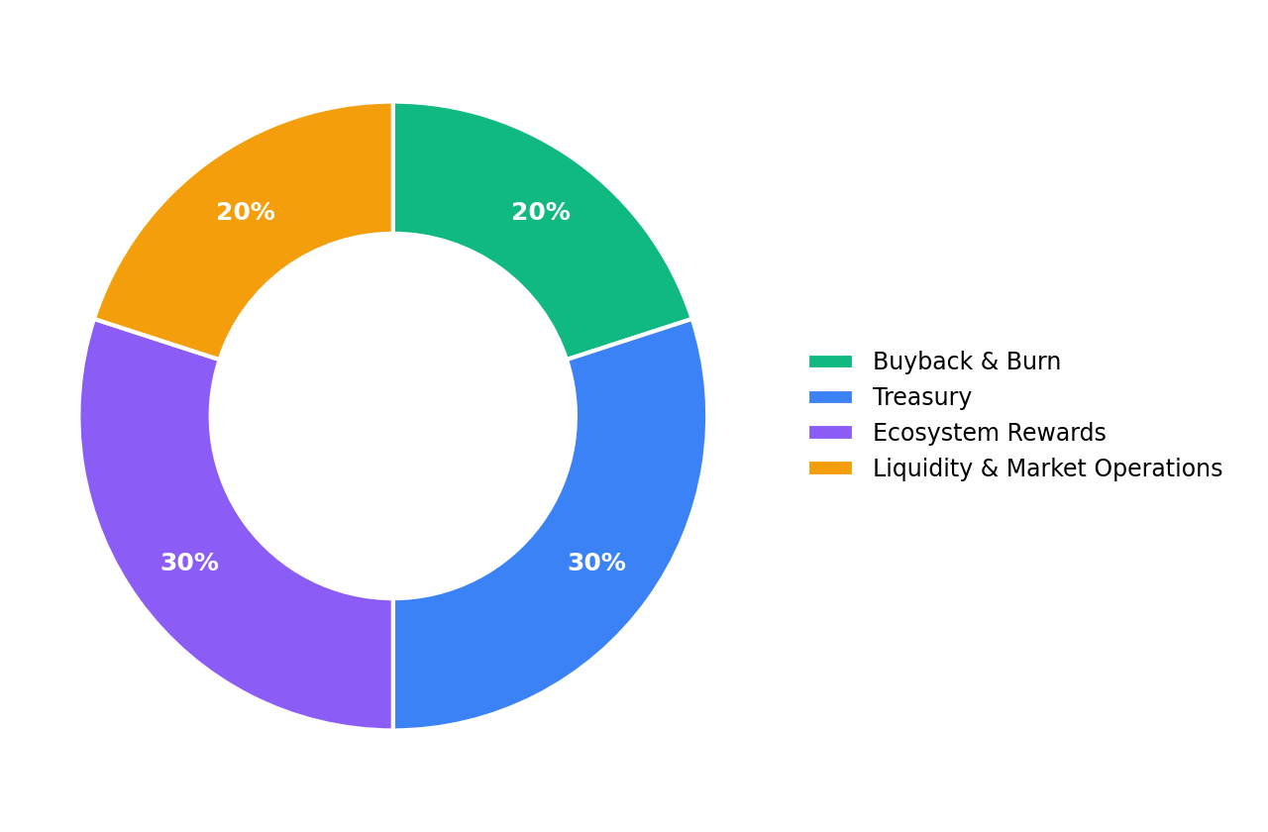
FEES PAID IN TCA ARE REDISTRIBUTED
Deflationary Model

Slide 12
Roadmap
Q2 2026: Concept & token design, Whitepaper & legal review, Landing page & waitlist
Q3 2026: MVP launch, AI services database (beta), Comparison engine (alpha), Team scaling, Smart contract development
Q4 2026: Contract audit & deploy, ICO & TGE, Staking v1, Rewards distribution begins
Q1 2027: AI agents marketplace (beta), Premium access via TCA, Rewards & curation, SMB onboarding
Q2 2027: B2B / API layer, Enterprise dashboard, Workflow templates, Partnerships
Q3–Q4 2027: Multichain launch, Governance expansion, Advanced reputation, Regional growth

Slide 13
CONTACTS
Join the AI Economy
• Website: techagent.com
• Email: info@techagent.com
• Token: TechCoinAgent (TCA) on Base
• Contract: 0x0F81294C2549D1CabAc3ecBbd0d21e2d073F2309
• BaseScan: https://basescan.org/token/0x0F81294C2549D1CabAc3ecBbd0d21e2d073F2309

